Slide 1
COMP 301 Analysis of Algorithms
Divide and Conquer

Slide 2
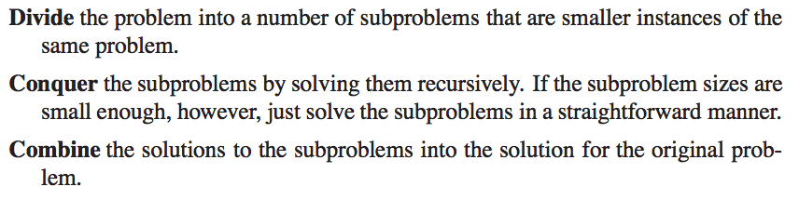
Divide and Conquer

Slide 3
Divide and Conquer
When sub-problems are large enough
Recursive case
When sub-problems are small enough
Base case
We might need to solve additional problems in combine step

Slide 4


Recurrences
A recurrence is an equation or inequality that describes a function in terms of its value on smaller inputs
The worst case running time of MERGE-SORT

Slide 5

Recurrences
General recurrence for divide and conquer

Slide 6
Recurrences
A recursive algorithm might divide subproblems into unequal sizes

Slide 7

Recurrences
Subproblems are not necessarily constrained to being a constant fraction of the original problem size
Example: Recursive version of linear search

Slide 8
Methods for Solving Recurrences
Substitution method
Recursion tree method
Master method

Slide 9
Methods for Solving Recurrences
Substitution method
Guess a bound and then use mathematical in- duction to prove that guess is correct

Slide 10
Methods for Solving Recurrences
Recursion tree method
Convert the recurrence into a tree whose nodes represent the costs incurred at various levels of the recursion
Use techniques for bounding summations to solve the recurrence

Slide 11

Methods for Solving Recurrences
Master method
Provides bounds for recurrences of the form
Example: a divide-and-conquer algorithm that produces a subproblems each is 1/b the size of the original problem

Slide 12
Recurrences as Inequalities

Slide 13

Technicalities in Recurrences
Call MERGE-SORT when n is odd
Floors and ceilings can be ignored

Slide 14

Technicalities in Recurrences
Boundary conditions
Typically assume that T(n) is constant for small n

Slide 15
Technicalities in Recurrences
But sometimes such details can be important
We should keep those in mind and know when they matter

Slide 16
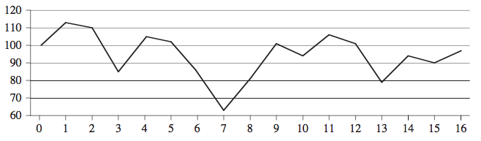

Maximum Subarray Problem
Maximizing profit in stock market
Suppose we know stock prices in the future
Buy and sell once

Slide 17
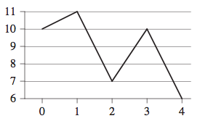

Maximum Subarray Problem
Maximum profit is not always between the lowest and highest prices

Slide 18
Brute-force Solution
Try every possible pair of buy and sell dates

Slide 19

Transform Problem
Instead of looking at daily prices and pairs of dates, consider daily change in price
Find the maximum subarray and sum the changes
Does not seem to help if brute-force approach is used again

Slide 20
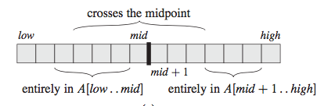
Divide and Conquer Solution
Goal: find a maximum subarray of A[low..high]
Divide the array into two A[low..mid], A[mid+1..high]
The maximum subarray can be in three possible regions

Slide 21
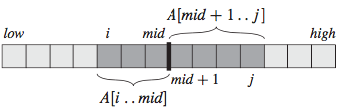
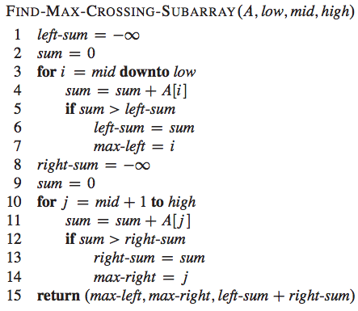
Maximum Subarray Crossing Mid Point

Slide 22
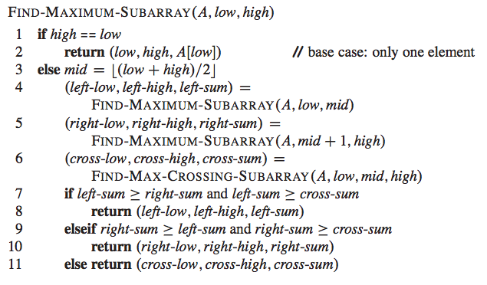
Divide and Conquer Algorithm

Slide 23


Analyzing the DAQ Algorithm

Slide 24
A Better Solution?
Linear time solution exists for maximum subarray
Exercise 4.1-5

Slide 25

Substitution Method
Guess a solution
Mathematical induction to find constants

Slide 26

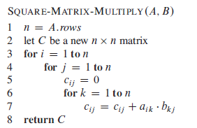

Strassen’s Matrix Multiplication
C = A . B

Slide 27
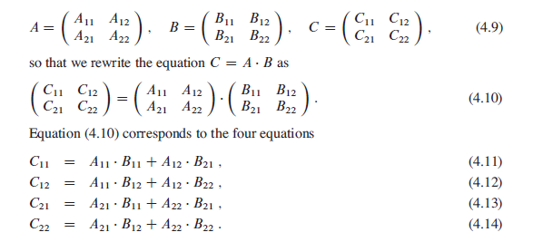
DAQ Algorithm for Matrix Multiplication

Slide 28
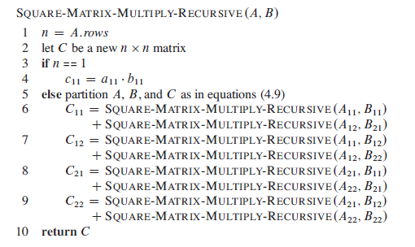



DAQ Algorithm for Matrix Multiplication

Slide 29
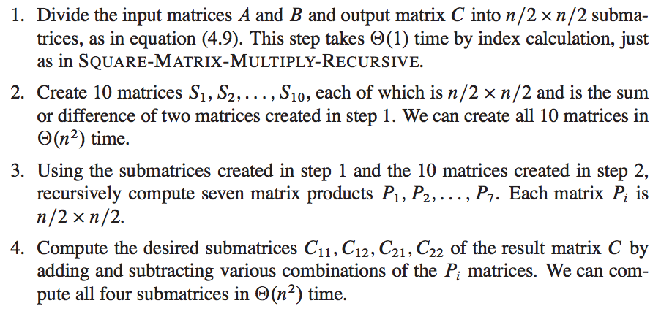
Strassen’s Algorithm

Slide 30





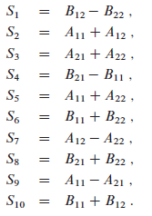
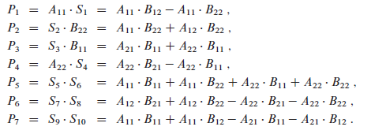




Strassen’s Algorithm

Slide 31
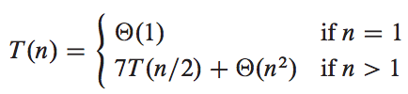

Strassen’s Algorithm

Slide 32
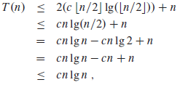
Substitution Method

Slide 33

Substitution Method

Slide 34
Correcting Initial Guess
T(n) <= cn/2 + cn/2 +1
<= cn + 1
T(n) <= cn/2 - d + cn/2 - d +1
<= cn -2d + 1 <= cn - d
d >=1

Slide 35


Avoiding Pitfalls

Slide 36
Changing Variables

Slide 37

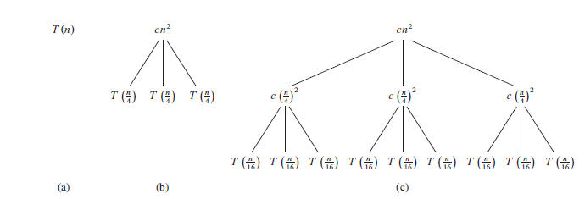
Recursion Tree Method

Slide 38
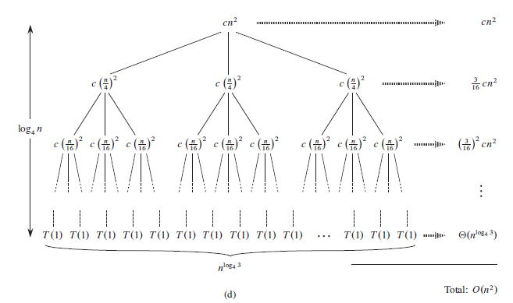
Recursion Tree Method

Slide 39
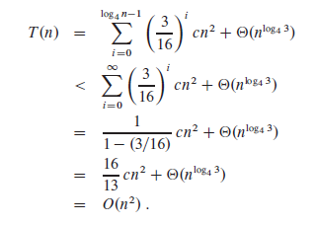
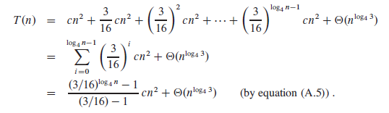
Recursion Tree Method

Slide 40
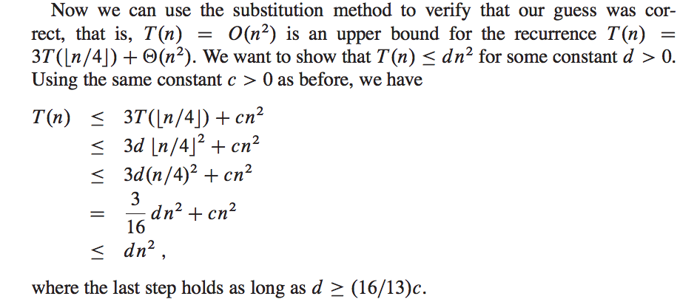
Verify by Substitution Method

Slide 41
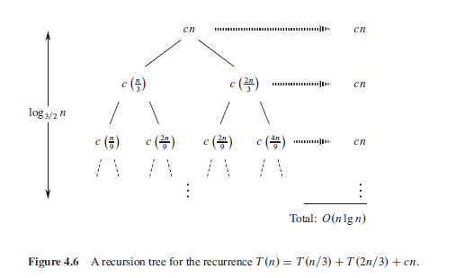
Recursion Tree Method

Slide 42
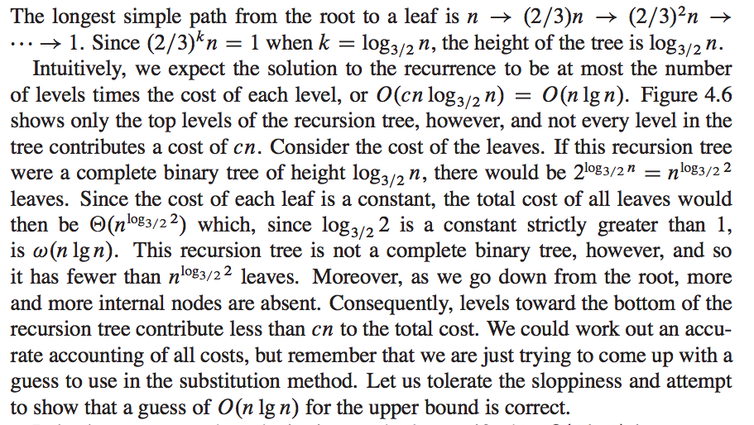
Recursion Tree Method

Slide 43
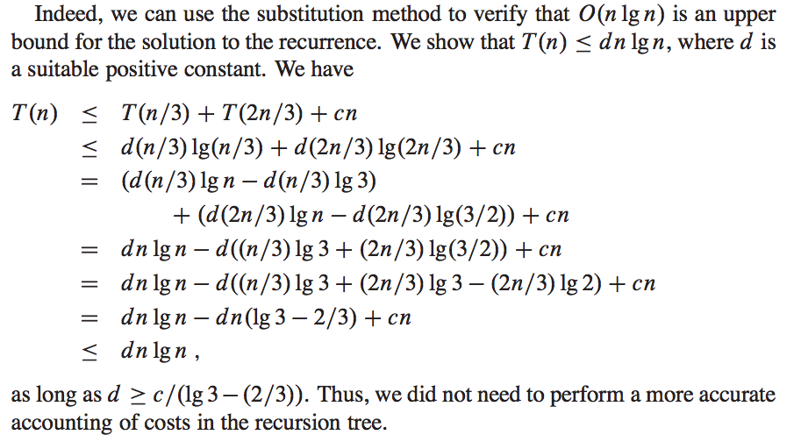
Verify by Substitution Method

Slide 44
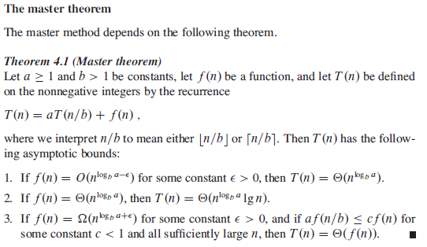
Master Theorem

Slide 45


Master Theorem Examples

